Slide 1

Sinhgad College of Engineering
Department of Computer Engineering
BE Project Stage I Presentation
on
Vidhan: A Gamified Approach to Learning the Indian Constitution with AI Assistance.
by
Patil Yashkumar Shamkant [72231439G] [405B046]
Lomte Dhanashree Sanjay [72308274L] [405B007]
Patil Tejas Kailas [72231433H] [405B047]
Khedkar Aditi Ambadas [72308261J] [405B006]
Under the guidance of
Prof. R.A.Vasmatkar
Sinhgad College Of Engineering, Pune-41 BE(Computer)

Slide 2
Vidhan: A Gamified Approach to Learning the Indian Constitution with AI Assistance.
Project Area
The project focuses on developing an interactive web platform that transforms learning about the Constitution into an engaging and game-like experience. The primary goal is to enhance constitutional literacy among citizens through gamification.
  Domain: Ed-Tech (Educational Technology) & Civ-Tech (Civic Technology)
  Subject Matter: The Constitution of India
  Core Objective: To simplify complex constitutional articles, amendments, and legal principles through interactive gameplay.
Sinhgad College Of Engineering, Pune-41 BE(Computer)

Slide 3
Motivation
Vidhan: A Gamified Approach to Learning the Indian Constitution with AI Assistance.
The "Boring" Barrier:
Traditional methods (dense textbooks, long articles) make learning the constitution feel difficult, not an opportunity. This alienates modern learners, especially students preferring interactive learning.
The Civic Knowledge Gap:
  When learning is difficult, a knowledge gap forms. Many citizens don't fully understand their fundamental rights, duties, or how their government works.
The Power of Interactive Learning:
We can transform this topic by making it active instead of passive. Gamification and interactivity turn learning into an engaging experience that is rewarding and memorable.
The Ultimate Goal: Empowered Citizens:
Our motivation is to build an informed and active citizenry. An accessible, fun platform empowers citizens and students with constitutional knowledge, we give them the confidence to understand their rights and responsibilities. This confidence is the first step towards creating a more engaged and active generation that participates meaningfully in democracy.
Sinhgad College Of Engineering, Pune-41 BE(Computer)

Slide 4
Vidhan: A Gamified Approach to Learning the Indian Constitution with AI Assistance.
Problem Statement
The Constitution of India is complex and difficult for students and the public to understand through traditional learning methods. This lack of engagement leads to low constitutional awareness.
The main reason is that it's full of complicated words, and just reading long pages of text isn't fun or interactive.
Because of this, many people don't really understand their basic rights and how their country is run. This makes them less likely to get involved in their community and country system.
Hence, there is a need for an interactive and game-based website that makes learning about the Constitution simple, fun, and effective.
Sinhgad College Of Engineering, Pune-41 BE(Computer)

Slide 5
Aim and Objectives of the project
Vidhan: A Gamified Approach to Learning the Indian Constitution with AI Assistance.
Aim : To transform constitutional education from a passive, text-based task into an engaging, interactive, and accessible experience that empowers citizens with functional knowledge of their rights and government.
Objectives :
Develop an Interactive Platform:
  To build a user-friendly website featuring gamified modules, quizzes, and real-world scenarios that cover the constitution's core principles.
Simplify Complex Information:
  To translate the dense, formal language of the constitution into simple, clear, and relatable content suitable for a broad audience, especially students.
Boost Learner Engagement:
  To implement game mechanics like points, badges, and progress tracking to motivate users, encourage consistent participation, and make learning enjoyable.
Foster Practical Understanding:
  To create content that connects constitutional concepts to everyday life, helping users understand not just what their rights are, but how they apply.
Promote Civic Confidence:
  To equip users with the knowledge and confidence needed to become active and informed participants in their communities.
Sinhgad College Of Engineering, Pune-41 BE(Computer)

Slide 6
Vidhan: A Gamified Approach to Learning the Indian Constitution with AI Assistance.
Introduction
In today’s digital age, technology plays a vital role in enhancing learning experiences. However, the Constitution of India, being a complex legal document, is often difficult for students and the general public to understand.
In this project, we are developing an interactive Constitution learning website that simplifies important topics such as the Preamble, Fundamental Rights, Duties, and Directive Principles through easy explanations and engaging visuals.
To make learning more enjoyable, the system also includes educational games and quizzes that help users test their knowledge and retain key concepts in a fun and interactive manner.
Sinhgad College Of Engineering, Pune-41 BE(Computer)

Slide 7
Vidhan: A Gamified Approach to Learning the Indian Constitution with AI Assistance.
Literature Survey
Sr No | Title | Publication Details | Seed Idea | Drawbacks
1 | CONSTITUTION CONNECT: A DIGITAL PLATFORM FOR PROMOTING CONSTITUTIONAL LITERACY USING MERN STACK | International Journal of Progressive Research in Engineering Management and Science (IJPREMS). | Leveraging the MERN stack to create an integrated digital platform that combines educational blogs, gamified quizzes, and an interactive chat-bot. The core concept is to simplify complex constitutional law into accessible, engaging, and interactive content to promote widespread constitutional literacy. | Limited Reach: Lacks multilingual support and in-depth content like case studies, restricting its audience and educational scope. Basic Tech: The chatbot is not advanced, and there are no community features like forums for user interaction. Simple Gamification: The platform is missing key engagement drivers such as leaderboards, badges, or a rewards system. Needs Expansion: Overall, it is a foundational version requiring significant enhancements to become a comprehensive resource.
Sinhgad College Of Engineering, Pune-41 BE(Computer)

Slide 8
Sr No | Title | Publication Details | Seed Idea | Drawbacks
2 | LawKey - Law Constitution Chatbot | IEEE - 2024 8th SLAAI International Conference on Artificial Intelligence (SLAAI-ICAI). | An NLP-driven retrieval system to map natural language questions to specific articles of the constitution. For a gamified learning website, this can be adapted into an interactive game mechanic. Instead of just a Q&A | Imperfect Accuracy: The system is not flawless and can occasionally misinterpret queries or recommend the incorrect law. Liability Risks: There is a potential for professional liability issues if the chatbot provides incorrect legal guidance due to machine errors. Feedback Dependency: The reinforcement learning model's performance is highly dependent on the quality and quantity of user feedback it receives to improve.
3 | Gamification as an e-learning tool: A Literature Review. | E-Learning Innovations Journal. | The results of the literature review indicate the need to systematize the existing gamification potential. Gamification of e-learning is becoming a real trend in the modern educational space. Online gaming platforms are gaining popularity among students due to their clear design and the demand for the digital cluster in the worldview paradigm of modern society. | Focus on Format Over Content: A key problem is ensuring the focus remains on the educational content itself, rather than getting lost in the game's format and design. Lack of Clear Implementation: There is no single, clear algorithm for how to best implement and integrate gamification into educational activities.
Sinhgad College Of Engineering, Pune-41 BE(Computer)

Slide 9
Vidhan: A Gamified Approach to Learning the Indian Constitution with AI Assistance.
Sr No | Title | Publication Details | Seed Idea | Drawbacks
4 | Centre for Law & Policy Research’s platform: ConstitutionofIndia.net | Website On Internet | The website ConstitutionofIndia.net is a flagship initiative by the Centre for Law & Policy Research focused on building a “constitutional culture” through digital public-goods tools. | Primarily oriented to archival/textual/debate materials; less emphasis on interactive, gamified learning for lay citizens or youth. Does not include strong gamification or AI-chatbot components designed for engagement.
5 | Constitution of India (UPSC) | App on Playstore | This app is designed primarily for aspirants of UPSC, SSC, and other civil service examinations. It provides comprehensive coverage of all articles, amendments, and schedules of the Indian Constitution. Its key focus lies in accuracy, offline accessibility, and exam-oriented structuring of content. | Focuses mainly on exam preparation, not conceptual understanding Lacks AI interaction or guidance for complex constitutional terms No gamified experience to maintain engagement Limited to student does not support civic engagement
Sinhgad College Of Engineering, Pune-41 BE(Computer)

Slide 10
Vidhan: A Gamified Approach to Learning the Indian Constitution with AI Assistance.
Scope of the project
Inclusion:
Development of an interactive web platform for learning the Constitution of India.
Integration of educational games, quizzes, and visual content to enhance engagement.
User-friendly interface suitable for students and general public.
Accessibility on both desktop and mobile devices for wider reach.
Detailed coverage of the Constitution of India.
Multilingual translation features.
AI-Assistance
Modules covering key topics such as Preamble, Fundamental Rights, Duties, and Directive Principles.
Exclusion:
Detailed coverage of advanced legal or judicial interpretations of the Constitution.
Offline learning or mobile app version (web-based only).
Real-time discussion forums.
Sinhgad College Of Engineering, Pune-41 BE(Computer)

Slide 11
Vidhan: A Gamified Approach to Learning the Indian Constitution with AI Assistance.
Software Requirement Specification
Functional Requirements:
User Management: Users must be able to register, log in, and manage their profiles.
Gamified Modules: The system will provide various interactive modules like quizzes, puzzles, and scenarios.
Progress Tracking: The platform must track and display user progress, scores, and achievements.
Leaderboard: A system to rank users based on their scores and display the rankings.
Content Management: An admin interface to add, update, and manage educational content.
Non-Functional Requirements:
Performance: Web pages and games should load within 3 seconds.
Usability: The interface must be intuitive, responsive, and accessible across major browsers and devices.
Scalability: The architecture must support a minimum of 1,000 concurrent users.
Security: All user data, especially personal information and passwords, must be encrypted and stored securely.
Reliability: The system should have an uptime of 99.9%.
Sinhgad College Of Engineering, Pune-41 BE(Computer)

Slide 12
Vidhan: A Gamified Approach to Learning the Indian Constitution with AI Assistance.
Software Requirement Specification
Hardware Requirements:
  Server:
    CPU: 2-core Processor
    RAM: 4 GB
    Storage: 50 GB SSD
  Client:
    A desktop, laptop, tablet, or smartphone with at least 2GB RAM and internet access.
Hardware Availability:
  The required hardware for both server and client is readily available and consists of standard consumer and enterprise-grade components. No specialized hardware is needed.
Software Requirements:
  Server:
    Operating System: Windows, Linux (e.g., Ubuntu 20.04+)
    Web Server: Apache Tomcat
    Database: MySQL
    Runtime Environment: Node.js 16.x+
  Client:
    A modern web browser (latest versions of Chrome, Firefox, Safari, or Edge).
Sinhgad College Of Engineering, Pune-41 BE(Computer)

Slide 13
Vidhan: A Gamified Approach to Learning the Indian Constitution with AI Assistance.
System Design
Home Module – Displays introduction, navigation menu, and overview of the Constitution.
Learning Module – Explains topics like the Preamble, Fundamental Rights, Duties, and Directive Principles in a simple way.
Games & Quiz Module – Offers interactive games and quizzes to test and improve knowledge.
User Module – Handles user registration, login, and progress tracking.
Admin Module – Enables admin to manage content, quizzes, and games.
Feedback Module – Collects user feedback and suggestions for improvement.
AI Assistance Module – Provides chatbot-based help, answers user queries, gives study recommendations, and explains with examples.
Evolution of Constitution Module – Explains the historical background, making of the Constitution, key committees, and important amendments in an interactive timeline format.
Sinhgad College Of Engineering, Pune-41 BE(Computer)

Slide 14
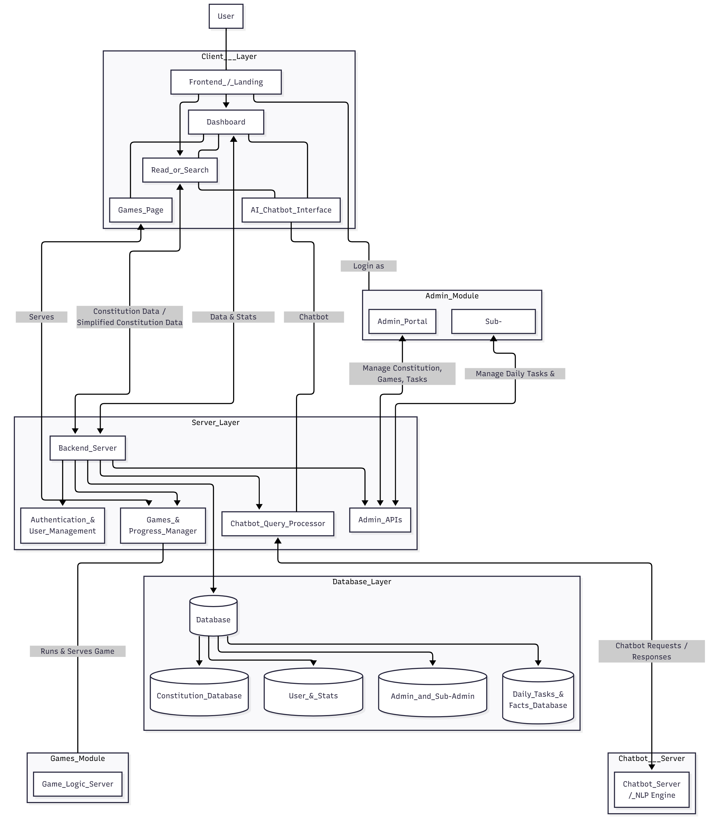
Vidhan: A Gamified Approach to Learning the Indian Constitution with AI Assistance.
System Architecture Diagram
Sinhgad College Of Engineering, Pune-41 BE(Computer)

Slide 15
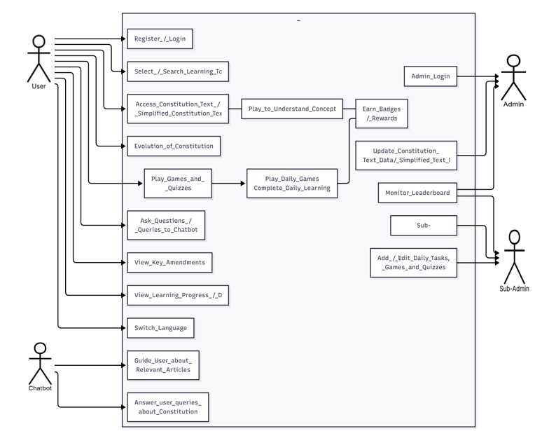
Use Case Diagram
Vidhan: A Gamified Approach to Learning the Indian Constitution with AI Assistance.
Sinhgad College Of Engineering, Pune-41 BE(Computer)

Slide 16
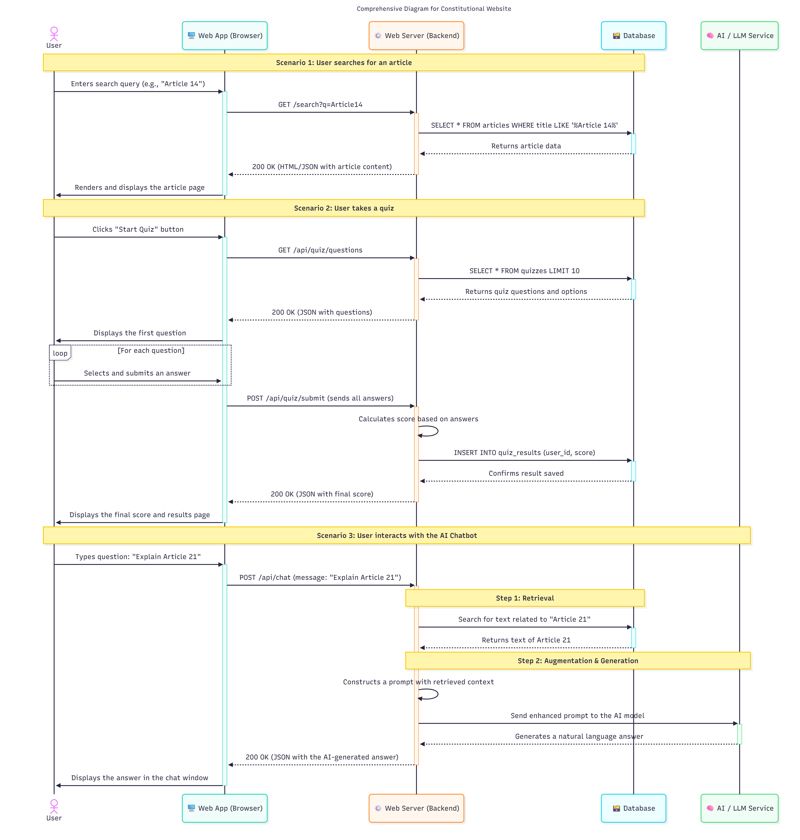
Vidhan: A Gamified Approach to Learning the Indian Constitution with AI Assistance.
Sequence Diagram
Sinhgad College Of Engineering, Pune-41 BE(Computer)

Slide 17
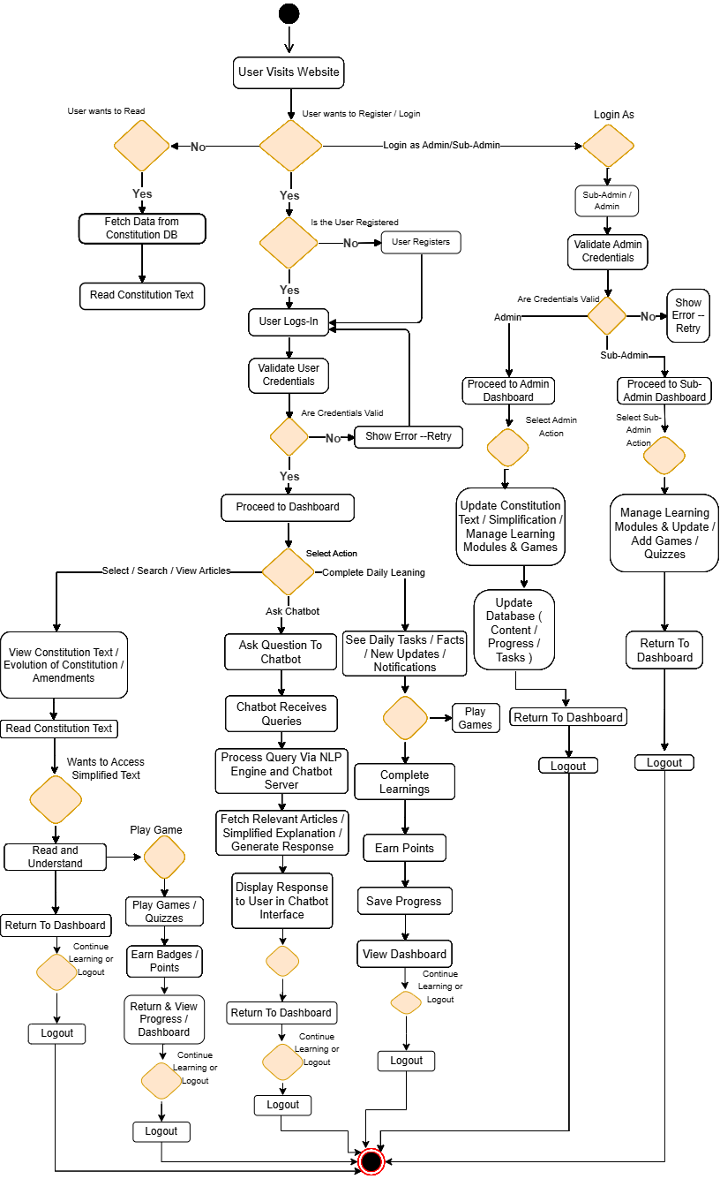
Vidhan: A Gamified Approach to Learning the Indian Constitution with AI Assistance.
Activity Diagram
Sinhgad College Of Engineering, Pune-41 BE(Computer)

Slide 18
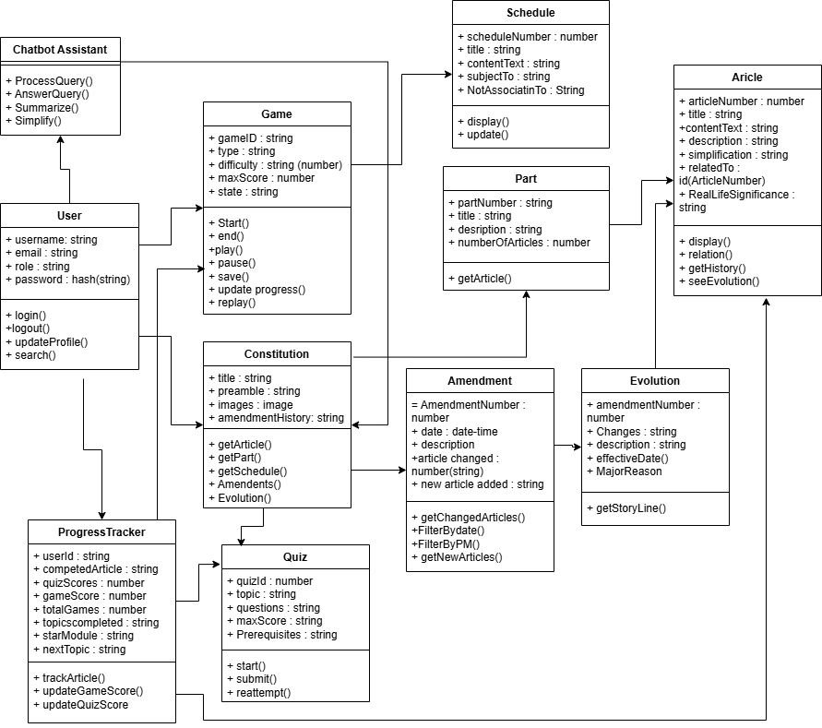
Class Diagram
Vidhan: A Gamified Approach to Learning the Indian Constitution with AI Assistance.
Sinhgad College Of Engineering, Pune-41 BE(Computer)

Slide 19
Vidhan: A Gamified Approach to Learning the Indian Constitution with AI Assistance.
Methodology and Algorithms
Overview
  Our platform integrates an AI-powered chatbot and interactive games to create an engaging and educational experience. We use a combination of Natural Language Processing, gamification principles, and a modern web development stack to bring the Constitution to life.
Chatbot Assistant
The AI assistant is designed to answer user questions about the Constitution in a conversational and accurate manner.
Core Technologies:
  Natural Language Processing (NLP): To understand and interpret user queries.
  Large Language Models (LLM): To generate human-like, context-aware responses.
  Vector Database: To efficiently search and retrieve relevant constitutional articles, amendments, and interpretations.
Algorithm Flow:
  Input Processing: The user asks a question (e.g., "What is the First Amendment?").
  Intent Recognition: The NLP model identifies the core intent of the query (e.g., seeking a definition).
  Information Retrieval: The query is converted into a vector and compared against our indexed database of the Constitution. The most relevant documents are retrieved.
  Response Generation: The LLM synthesizes the retrieved information into a clear and concise answer.
  Citation: The response includes a reference to the specific article or section of the Constitution for verification.
Sinhgad College Of Engineering, Pune-41 BE(Computer)

Slide 20
Vidhan: A Gamified Approach to Learning the Indian Constitution with AI Assistance.
2. Interactive Games & Quizzes
Gamification is used to enhance learning, retention, and user engagement.
Methodology: Gamification
Points, badges, and leaderboards are used to motivate users.
Immediate feedback helps reinforce learning.
Quiz Algorithm:
Question Bank: A structured database holds questions categorized by constitutional article, theme (e.g., Bill of Rights), and difficulty level.
Dynamic Selection: A set of questions is randomly selected based on the user's chosen topic and difficulty.
Scoring Logic: The user's score is calculated in real-time. Score = (Correct Answers / Total Questions) * 100.
Instant Feedback: After each answer, the system provides the correct response along with a brief explanation, citing the relevant constitutional text.
Sinhgad College Of Engineering, Pune-41 BE(Computer)

Slide 21
Vidhan: A Gamified Approach to Learning the Indian Constitution with AI Assistance.
Example - "Match the Amendment" Game Logic:
Data Pairing: A predefined set of key-value pairs (Amendment Number: Description) is loaded.
Randomization: The descriptions and amendment numbers are separated and randomly shuffled into two distinct lists.
Validation: The user's pairings are compared against the original correct data set to determine the score.
3. Overall Development Methodology
Framework: Agile Development
  The project is developed in iterative sprints, allowing for continuous feedback and improvement.
  Each sprint focuses on a specific feature, such as chatbot enhancements or a new game.
Technology Stack:
  Frontend: React for a responsive, component-based user interface.
  Backend: Java Spring to manage the AI model, game logic, and APIs.
  Database: MySQL for storing user progress, quiz questions, and constitutional data.
Sinhgad College Of Engineering, Pune-41 BE(Computer)

Slide 22
Vidhan: A Gamified Approach to Learning the Indian Constitution with AI Assistance.
Conclusion
This project successfully demonstrates how technology can revolutionize civic education. By uniting the foundational text of the Constitution with an intelligent AI assistant and the interactive nature of games, we have created a platform that makes learning not only accessible but also genuinely engaging. This innovative approach demystifies complex legal concepts and fosters a deeper, more lasting understanding of the principles that govern our society, paving the way for a more informed and participatory citizenry.
Bridging History and Technology: We have successfully created a unique platform that fuses the foundational principles of the Constitution with the power of AI and the engagement of gamification.
AI as a Personal Tutor: Our AI assistant demystifies complex legal language, making constitutional knowledge accessible and understandable for learners of all ages and backgrounds.
Gamification for Deeper Learning: By transforming constitutional articles and amendments into interactive games, we have proven that learning about civics can be engaging, memorable, and effective.
A Blueprint for Modern Education: This project serves as a powerful model for how foundational civic documents can be revitalized for a digital-first generation, fostering a more informed and engaged citizenry.
Sinhgad College Of Engineering, Pune-41 BE(Computer)

Slide 23
Vidhan: A Gamified Approach to Learning the Indian Constitution with AI Assistance.
Future Scope
Content Expansion: Introduce modules on landmark Supreme Court cases, historical context, and comparisons with global constitutions.
Enhanced AI Capabilities: Develop more advanced AI features, including personalized learning paths based on user performance and Socratic-style debate simulations.
Community & Collaboration: Launch multiplayer games, class leaderboards, and teacher-focused dashboards to build a collaborative learning community.
More Content: Adding historical case studies and comparing constitutions from other countries.
Team Competitions: Introducing multiplayer quizzes, team challenges, and national leaderboards.
Mobile App: Launching dedicated apps for Android and iOS for learning anywhere.
More Languages: Adding support for various regional languages to reach more users.

Slide 24
References
Vidhan: A Gamified Approach to Learning the Indian Constitution with AI Assistance.
[1]. S. Naveen, M. Salmaan, and E. Sivamuthu. "Constitution Connect: A Digital Platform for Promoting Constitutional Literacy Using MERN Stack," International Journal of Progressive Research in Engineering Management and Science (IJPREMS), vol. 04, no. 12, pp. 948-952, [Year - 2024]
[2]. W. S. Fernando, M. Handapangoda, M. Gamage, N. Samindi, and D. Alwis, "LawKey - Law Constitution Chatbot," in 2024 8th SLAAI International Conference on Artificial Intelligence (SLAAI-ICAI), 2024, doi: 10.1109/SLAAI-ICAI63667.2024.10844946. [Year - 2024]
[3]. P. Halachev, PhD in Informatics and Computer Science, Assistant Professor, Department of Informatics, University of Chemical Technology and Metallurgy, Sofia, Bulgaria "Gamification as an e-learning tool: A Literature Review," E-Learning Innovations Journal, vol. 2, no. 2, pp. 4-20, 2024, doi: 10.57125/ELIJ.2024.09.25.01. [Year – 2024]
Sinhgad College Of Engineering, Pune-41 BE(Computer)

